Slide 1


Land Degradation
Meaning
Types
Causes
Effects
Solution
Land Degradation
in India

Slide 2

What is Land Degradation?
Land degradation means the decline in land quality.
It happens when the land becomes less useful for farming, forests, or living.

Slide 3
Types of Land Degradation
Soil erosion: Loss of topsoil by wind or water
Desertification: Fertile land turning into desert
Salinization: Too much salt in soil
Waterlogging: Too much water in soil
Contamination: Pollution from chemicals or waste.

Slide 4

Causes of Land Degradation (Natural Causes)
Heavy rainfall or floods
Droughts
Strong winds
Earthquakes or landslides

Slide 5
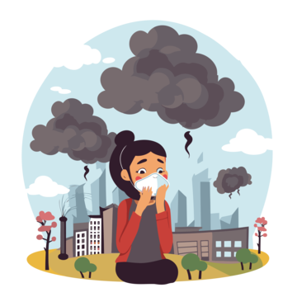
Causes of Land Degradation (Human Activities)
Deforestation
Overgrazing by animals
Overuse of chemical fertilizers
Mining
Poor farming practices
Urbanization and construction

Slide 6
Effects of Land Degradation
Less food production
Loss of soil fertility
Water cycle disruption
Destruction of habitats
Increase in poverty
Forced migration

Slide 7
Land Degradation in India
About 30% of land in India is degraded
Main states affected:
  Rajasthan
  Madhya Pradesh
  Maharashtra
  Gujarat
Causes in India: Deforestation, mining, overgrazing, poor irrigation

Slide 8
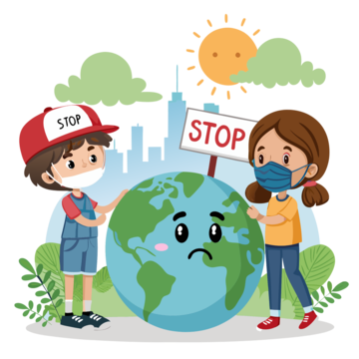
Solutions to Land Degradation
Plant more trees
Use organic manure
Water conservation methods
Control overgrazing
Ban illegal mining

Slide 9

Thanks for Watching
Please Like Share
& Subscribe
Asaan Bhasha Mein

